Slide 1
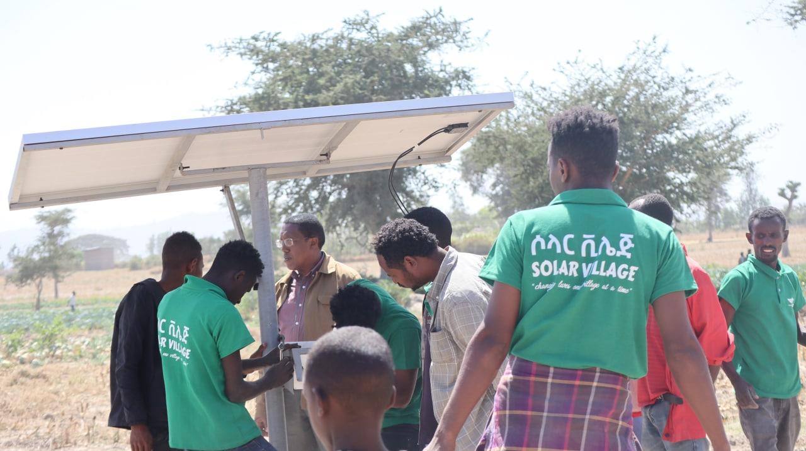

Solar Village Ethiopia
Our Aspiration
Changing lives, one village at a time!!!

Slide 2
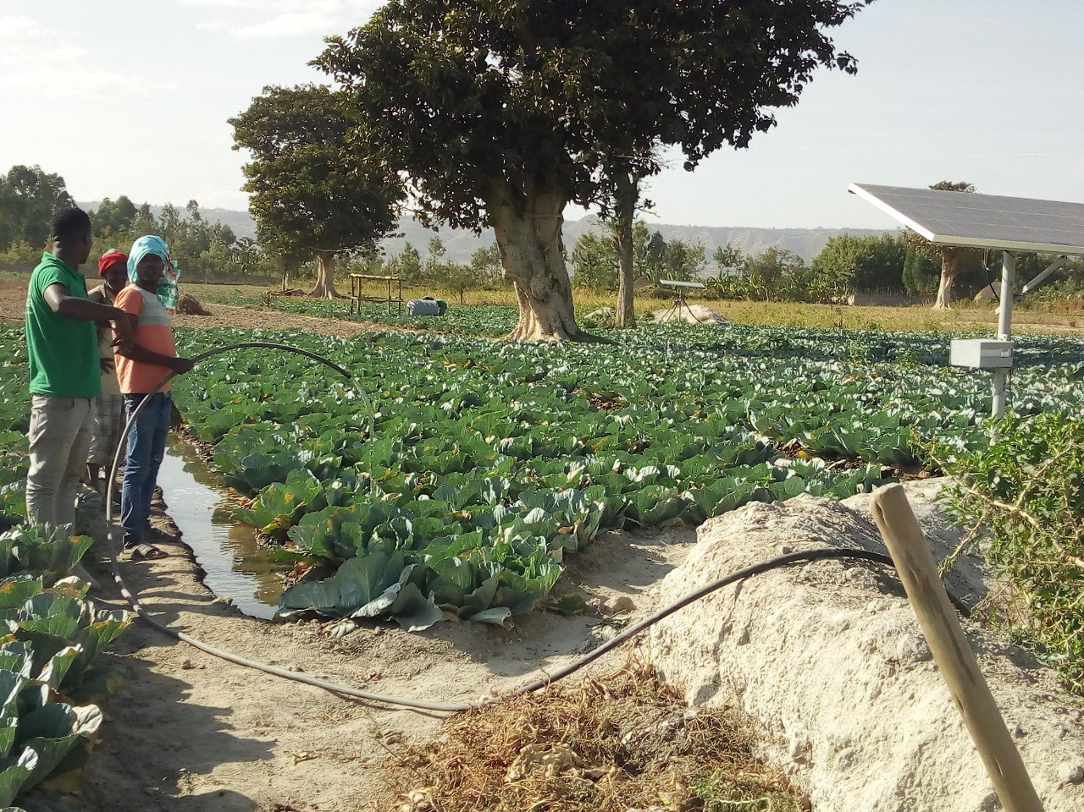
CONTENTS
01
About Us
02
Our Core Values
03
Areas of Work
04
Our Product
05
Company structure
06
Testimonial Vedios
07
Our partners

Slide 3


About Solar village
Our Vision
Solar Village envisions an interconnected; mini-grid empowered villages and rural communities with better standard of living and improved incomes
Our Mission
To supply quality, affordable, proven solar technologies, primarily to the rural community, with locally accessible network of dependable after-sales care and development of empowered rural youth establishments for delivery and service.
Changing lives, one village at a time!!!

Slide 4






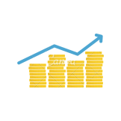


Our core values
Social and Environmental Impact
Our priorities
Improved Livelihoods
Quality before anything:
Dependable after-sales service network by rural establishments
Efficient Energy Source
Environmental protection
When the community grows, so does our business:
Enabling Access to Finance and Business Support
Services:
Water conservation
we create job oppoutunity for youth and womans so that,
together for a stronger impact

Slide 5

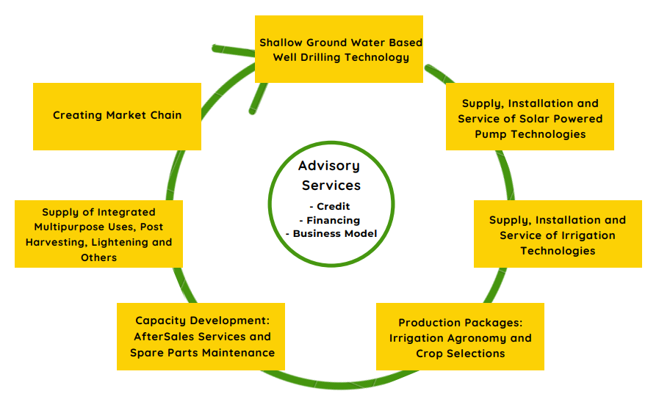





Area of work
Supply and Installation of Solar powered irrigation system.
After sales services and Maintenance.
Borehole drilling for shallow wells.
Facilitation of loan/financing options
Joint extension trainings and production consultations.
Introduction of drip and sprinkler irrigation technology.

Slide 6

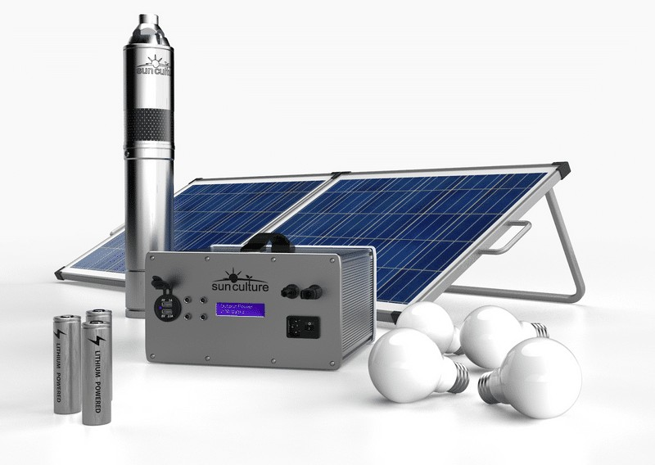

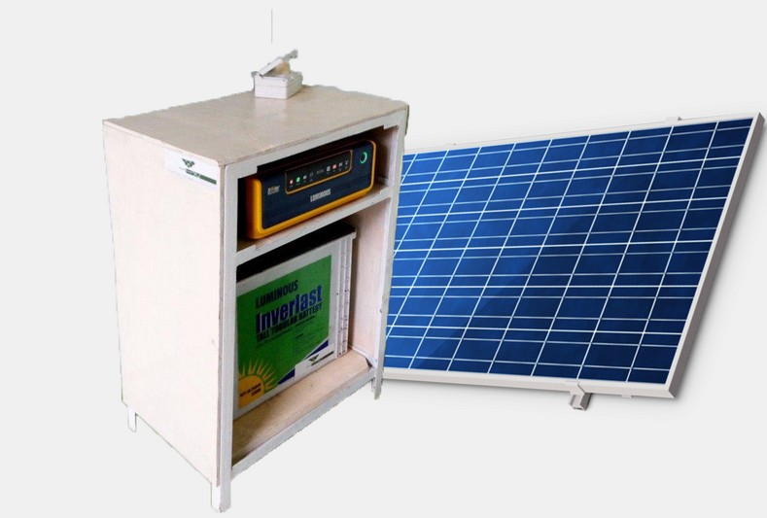

Our Products
Some of our products
Some of Our Brands at a glimpse
Solar pumps
Submersible and Surface pumps.
RainMaker2 with ClimateSmart™ Solar Irrigation Pumps - SunCulture
Coming products:-PUE solutions like Incubator, solar generators, Refrigerators, Milk Processing,drying and cooling...
Lanterns and Household Systems
All-in-One Solar Generator
Drip systems, Sprinkler, and other water saving technologies.

Slide 7
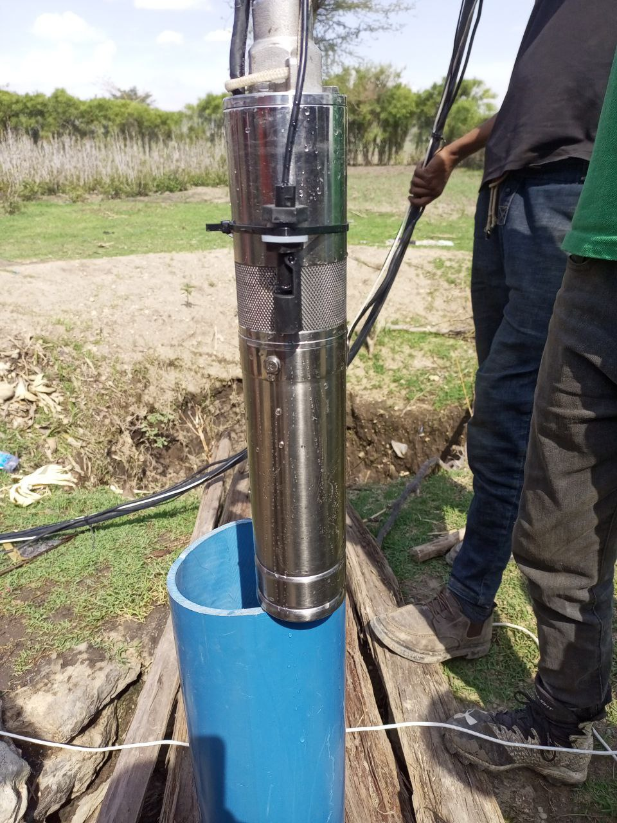
Rainmaker 2S with Battery
Max Head=70meter
Max flow Rate=1.2m3/h
solar panal (PV)=160w
Battery=1*external pump switch and 2*Mc4 Extension cable
Lights=four LED light bulbs with 5m cable
Irrigation Fittings=3 butterflay sprinkiler and one jet sprinkler

Slide 8
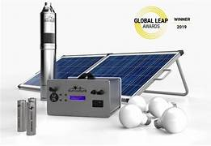
Rainmaker 2c with Battery
Max Head=20 meter
Max flow Rate=3 m3/h
solar panal (PV)= 310w
Battery=1*external pump switch and 2*Mc4 Extension cable
Lights=four LED light bulbs with 5m cable.
Irrigation Fittings=3 butterflay sprinkiler and one jet sprinkler
Water Pipe= 50m of 25mm Pn10

Slide 9
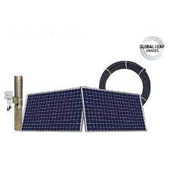
Rainmaker 2c Direct
Max Head=30meter
Max flow Rate=2.8 m3/h
solar panal (PV)= 620w
Battery=1*external pump switch and 2*Mc4 Extension cable
Lights=four LED light bulbs with 5m cable.
Irrigation Fittings=3 butterflay sprinkiler and one jet sprinkler
Water Pipe= 50m of 40mm Pn10

Slide 10
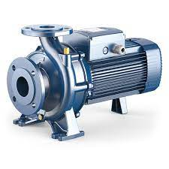
Surface pump
Pump power = 900W
Max Head=10meter
Max flow Rate =23m3/h
solar panal (PV)=1kW
S&D pipe size =50mm
Application =Irrigation, Livestock and fish farming

Slide 11
Solar productive use equipment's installed
 | No. of installed solar Pumps
The Federal Democratic Republic of Ethiopia Ministry of Agriculture | 120
Amhara National Regional State Bureau of Agriculture. | 495
Southern Nations, Nationalities, and Peoples Region (SNNPR) State Bureau of Agriculture and Natural Resource Development | 131
Oromia Agricultural and Natural Resources Bureau | 103
United states agency for international development (USAID). | 36 (Solar power generators)
Concern worldwide. | 5
International committee of the Red Cross (ICRC) | 10

Slide 12
Cont...
 | No. of installed solar pumps
Agricultural transformation agency (ATA) | 22
Care Ethiopia. | 17
Organization for Rehabilitation and Development in Amhara (ORDA). | 13
Precise consult international PLC | 5
Sidama Region agriculture bureau. | 36
Gambella Regional state | 2
Somaliya Regional state | 20
Total | 1015

Slide 13
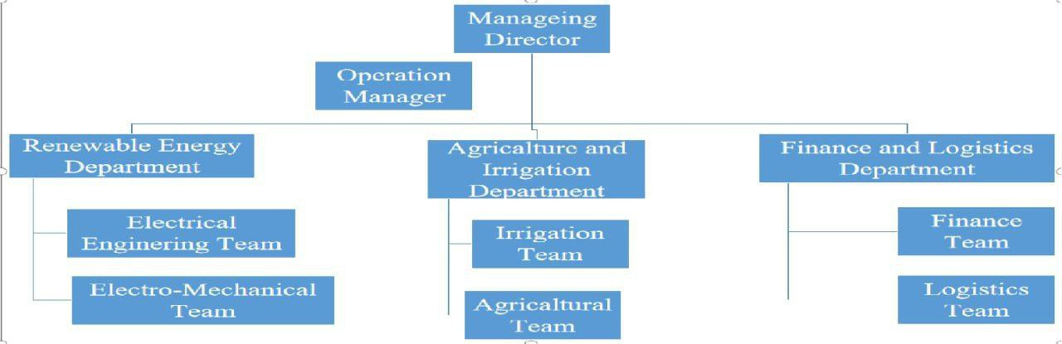
Company Structure

Slide 14
Training

Slide 15
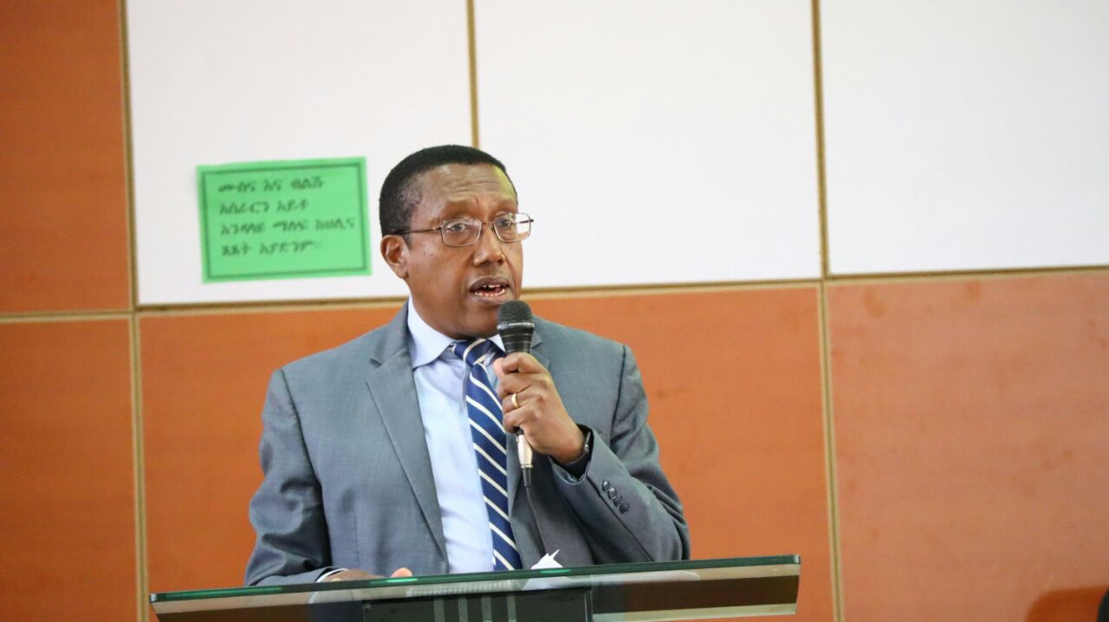
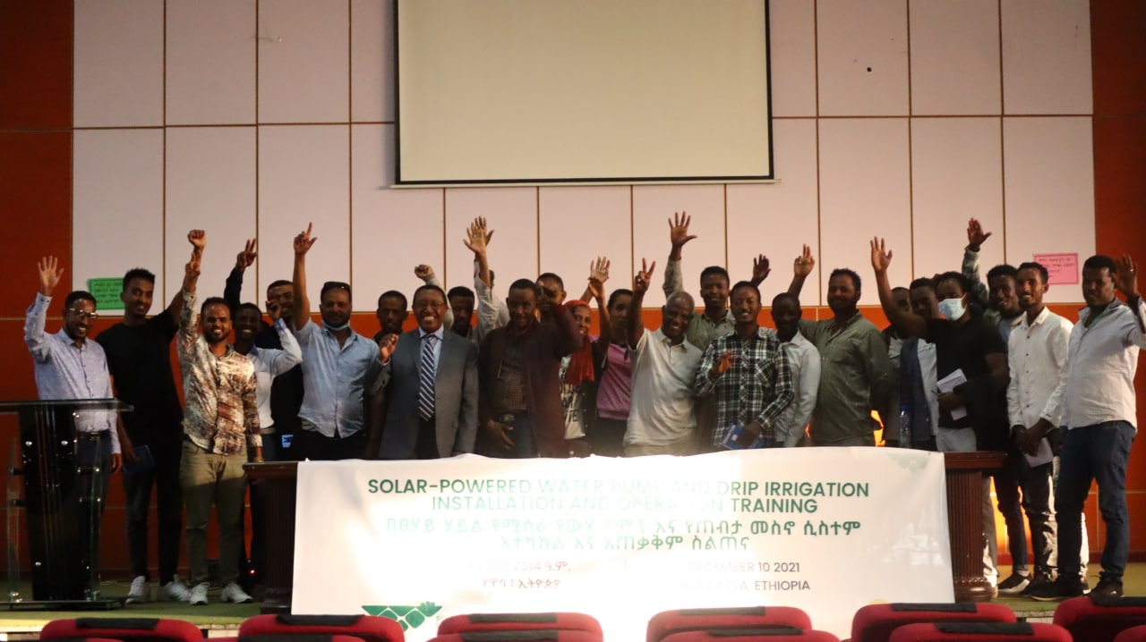

Training in Sidama and SNNP Regions

Slide 16
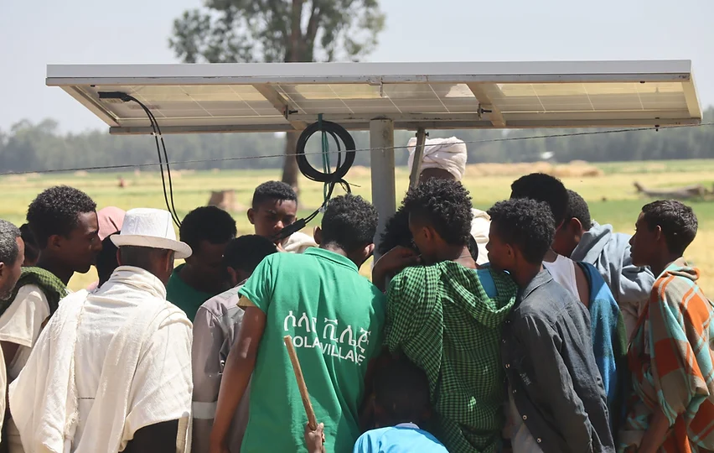
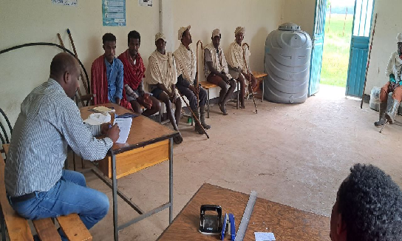
Training in Amhara Region, (practically and teoretically)

Slide 17
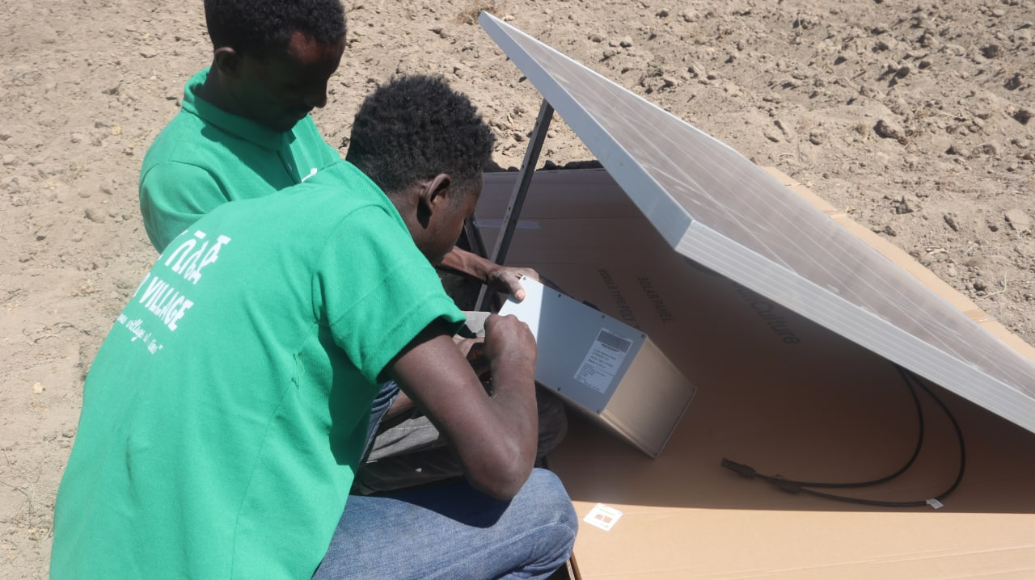

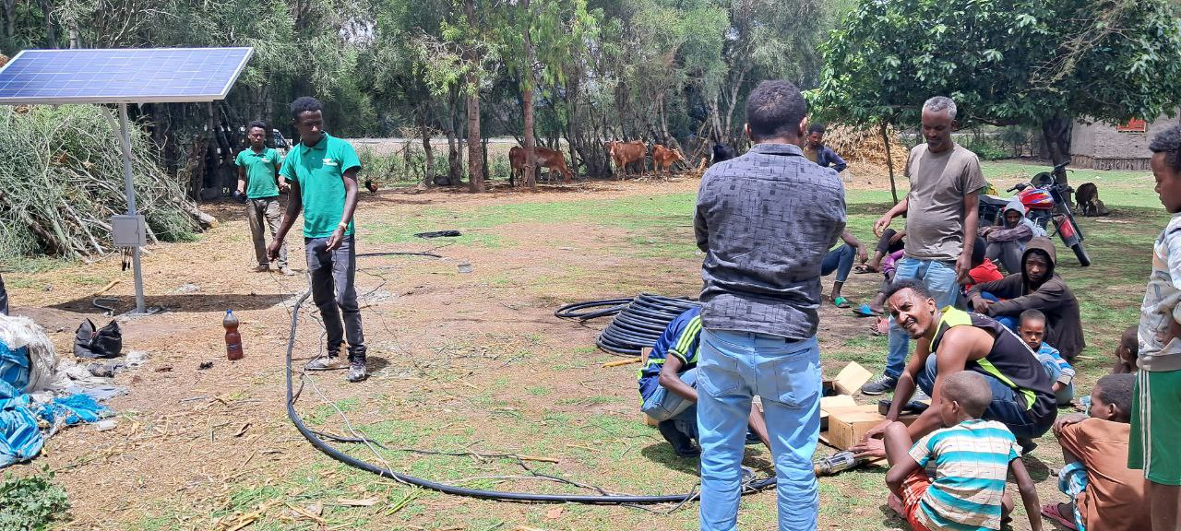
SNNP and SIDAMA Region TVET Students Solar pump installation training

Slide 18
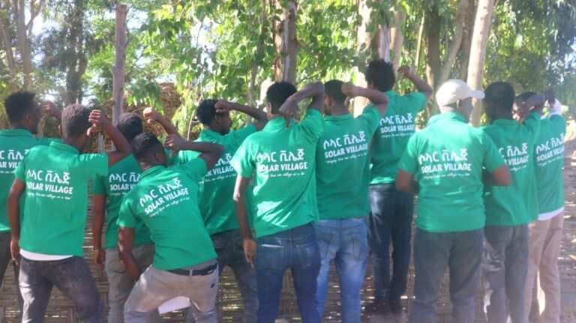
Job oppourtunity for Youths

Slide 19
Installation

Slide 20
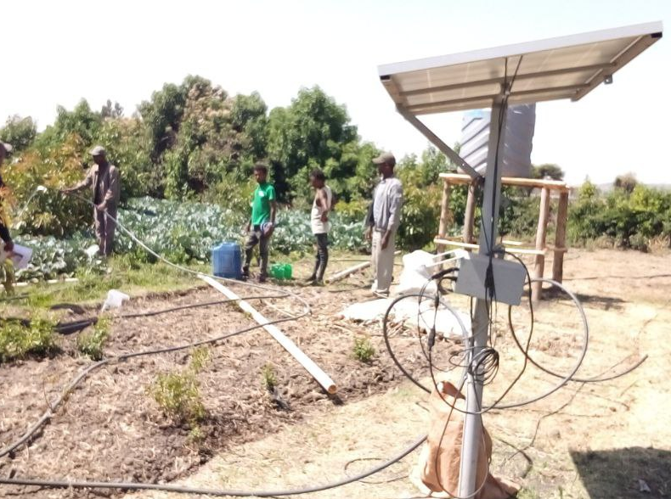
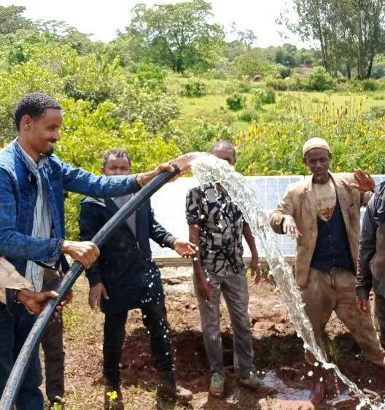
Oromia Region, Jimma and Ada’a woreda(solar powered pump and watersaving technology

Slide 21
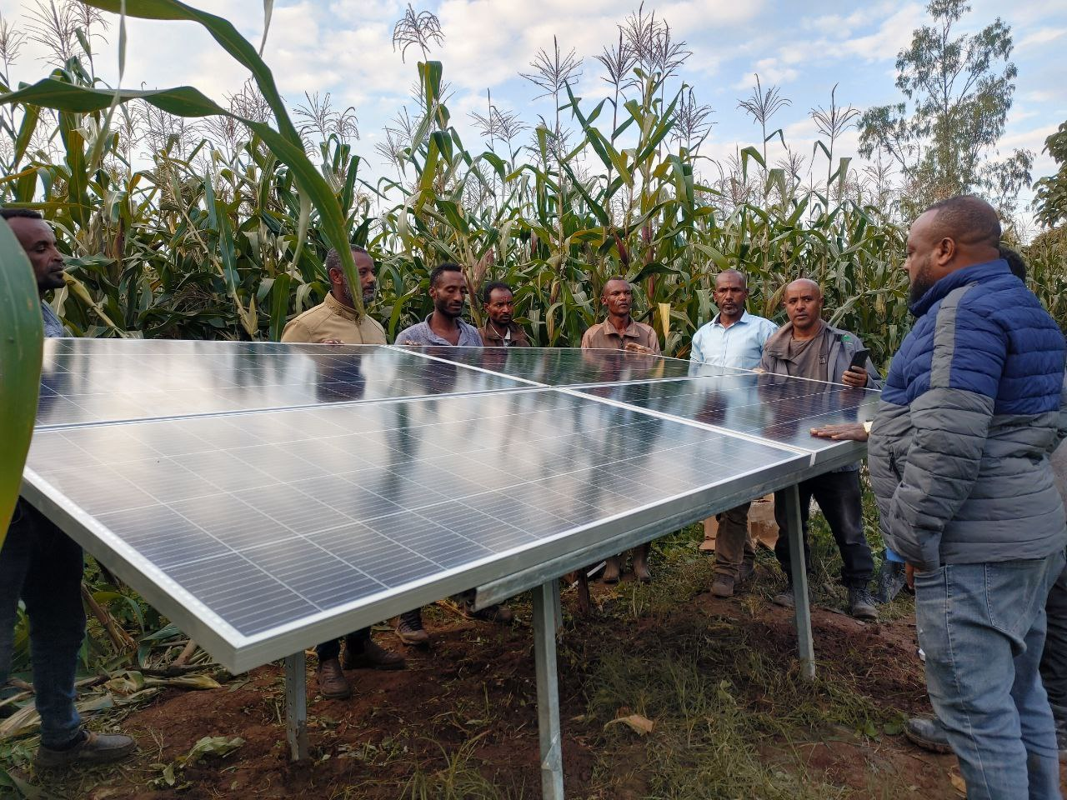
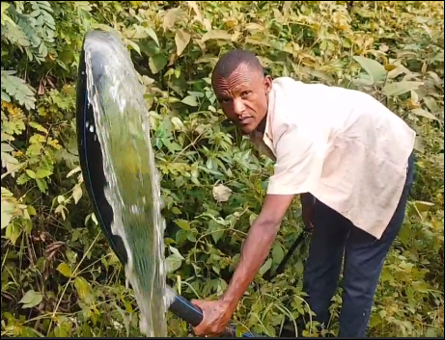
Solar surface pumps installed in Jimma. Financed by EOC-DICAC

Slide 22
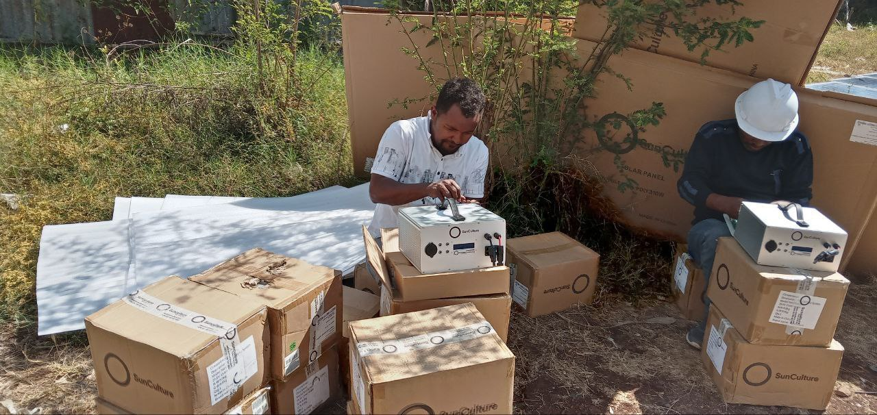

Slide 23

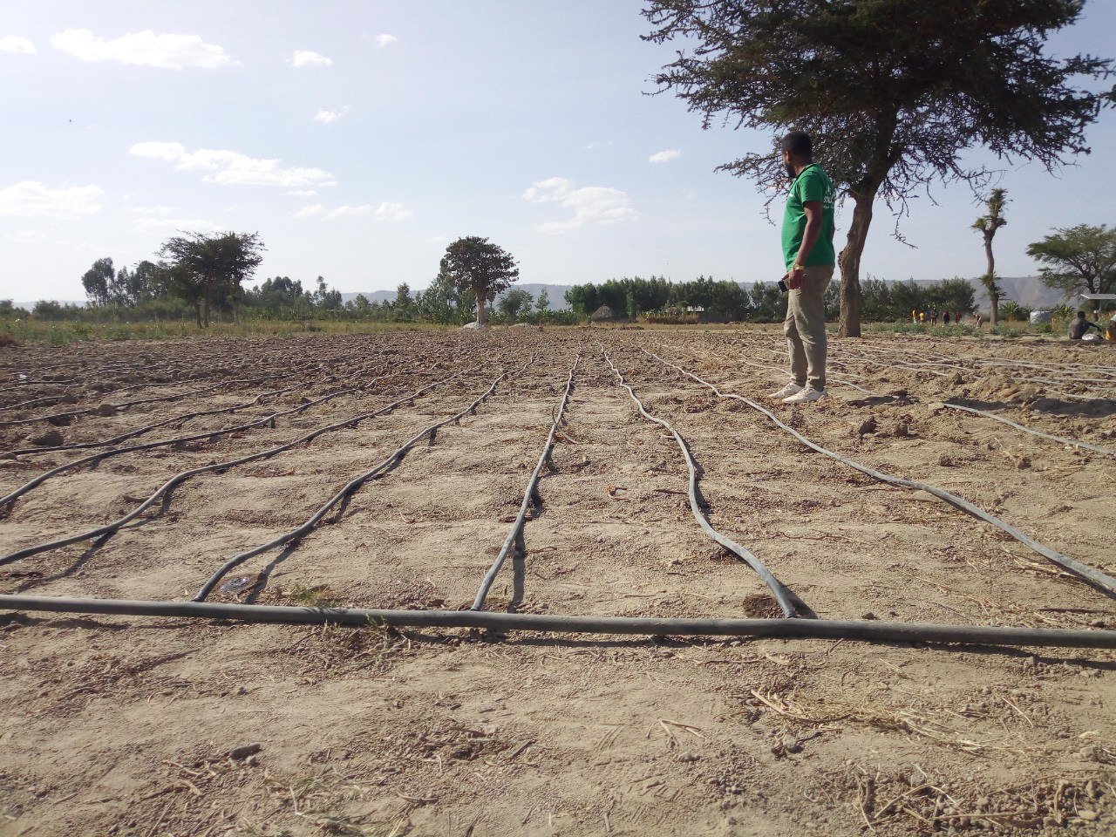
Sidama Region, Hawasa Zuria or Dela woreda (solar powered pump with water saving technology installation)

Slide 24
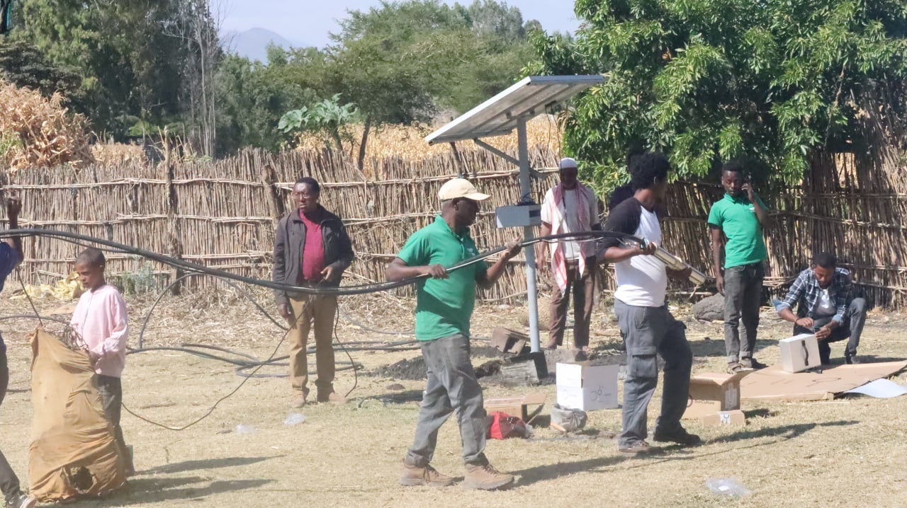
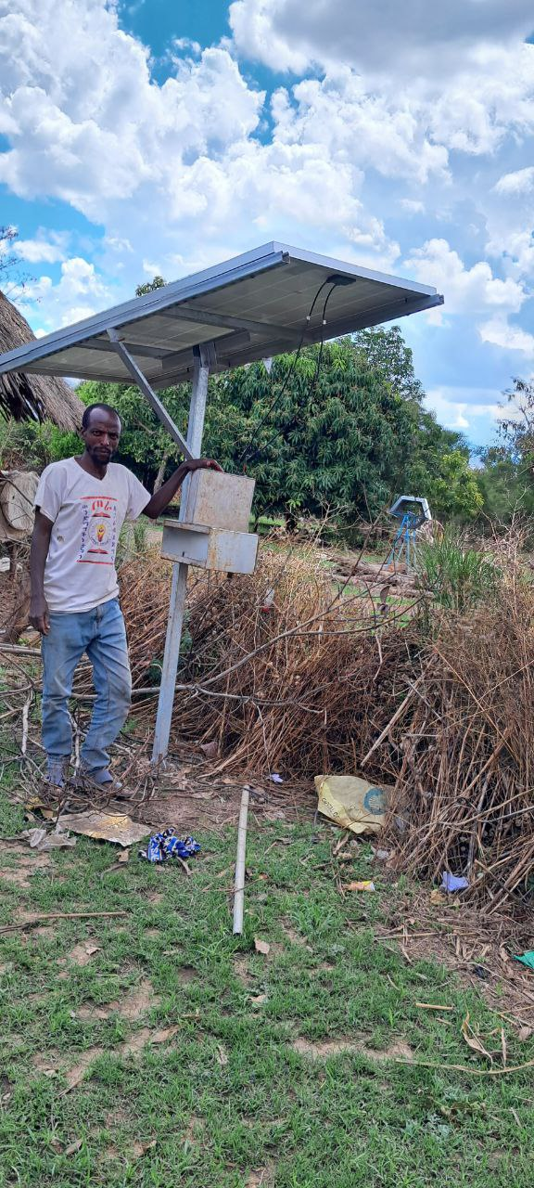
SNNP Region, Mareko woreda and lanforo wereda (solar powered pump with water saving technology installation)

Slide 25
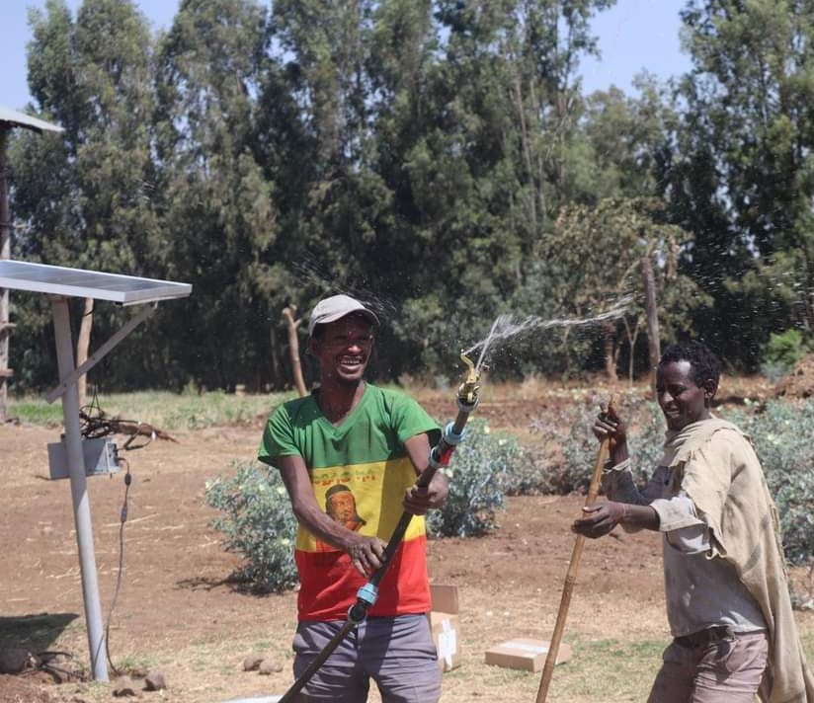
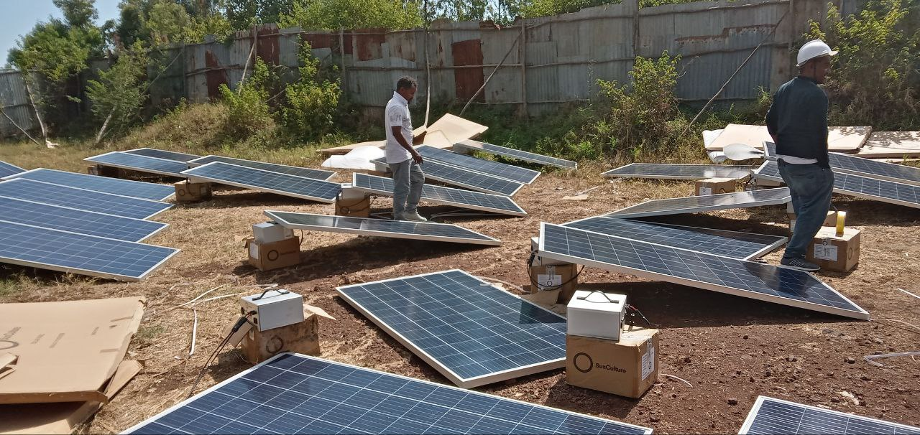
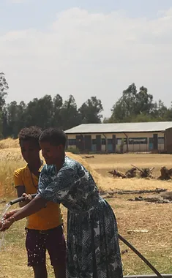
Amhara Region,Fogera woreda (solar pump and water saving technology.

Slide 26
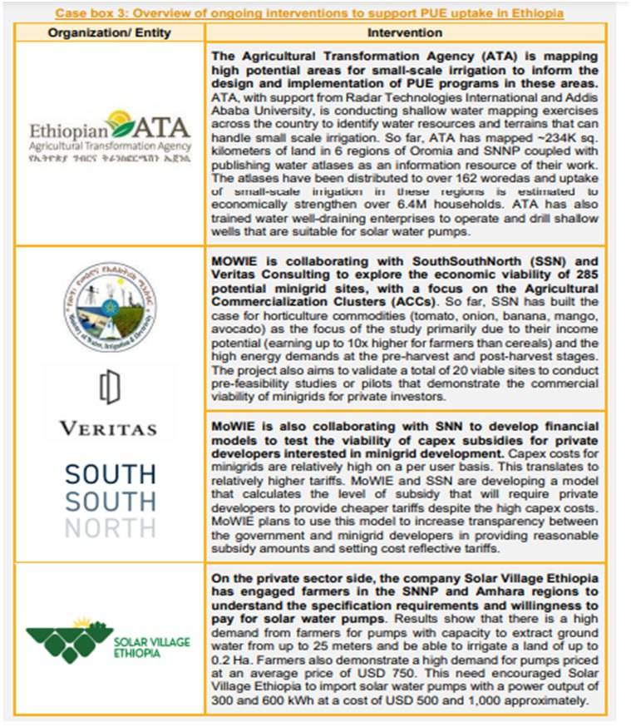
Testimonials
Sheno town, kembibit woreda
(Creation, Energy, and June 2021)

Slide 27
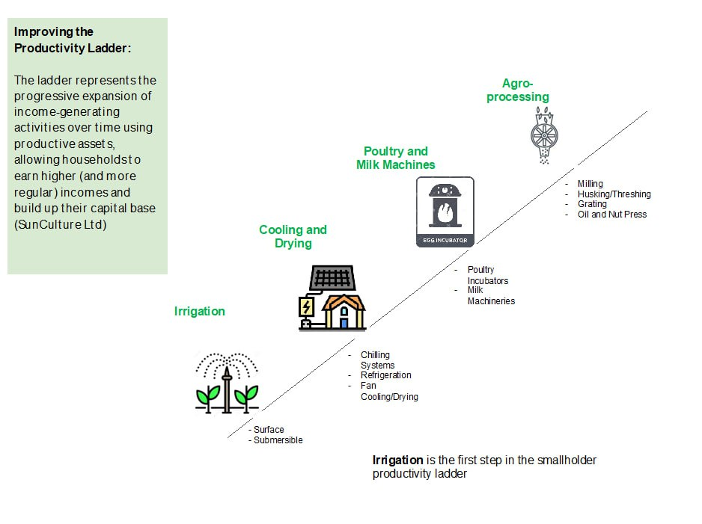
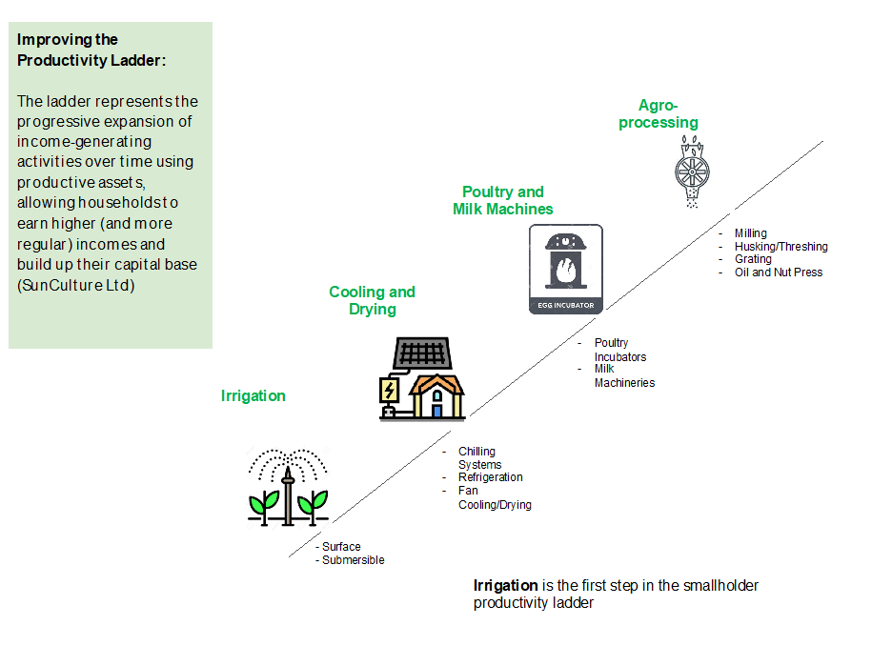
Cont…
Future Plan

Slide 28

Solar assembly plant project
Partnering with Jebdu Motors which is located in Bishoftu town of Oromia Regional State.
It’s a company which manufactures and assembles tools for agricultural production.
We partnered to assemble solar productive use equipments in 2022.
The assembly lines are ready waiting for foreign currency approval to import the parts.

Slide 29
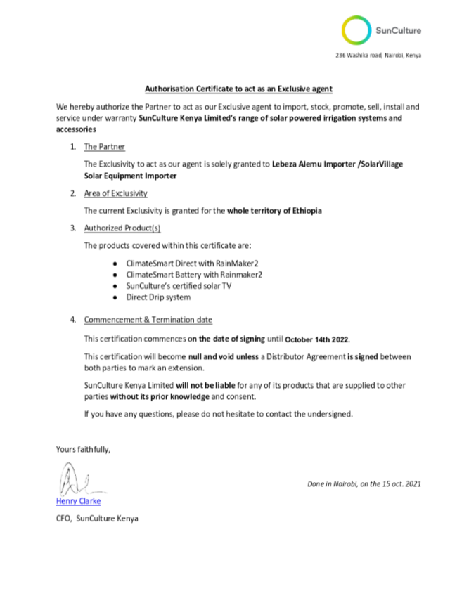


Partnership with SunCulture

Slide 30







Our Partners

